Slide 1
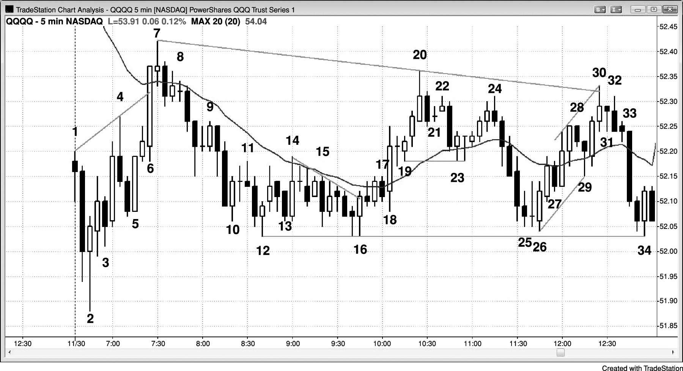
FIGURE 21.1 Fading Extremes for Scalps in Trading Ranges

